Slide 1

ALGORITHM DESIGN AND ANALYSIS(SE-303)
DELHI TECHNOLOGICAL UNIVERSITY(DTU)
PROJECT ON STARTUP WEBSITE
Submitted by:
Anmol Yadav - (2K18/SE/028) Ashish Kumar - (2K18/SE/041)
Submitted to :
Mr. Rahul Gupta

Slide 2
INTRODUCTION
As everything is digitalizing in this era, business also needs online handle, where everything is accessible on click of two fingers. Our aim is to provide people with websites, so that they could take their business online to expand their reach and accessibility.
This presentation provides a brief introduction to our project i.e. startup website. It goes through all the introductory information, explanation of different modules of the project, tools and technologies used, GitHub link of the implementation code and sources we used to complete this project.
With this project, the interaction front of the startup named ‘WebHelper’, is managed. This website provides all the necessary details about the startup, contact information including emails, social media profiles on WhatsApp, Twitter and Instagram which are one click redirects.
This website also provides an interactive experience wherein the users can browse through the services we provide, looks at our previous projects and websites we made, contact directly through email, if interested in taking business online with us.
This website displays our motivation and ideology behind our startup initiative. It also mentions people behind this startup and their social media profiles.
Through this website, the developers who want to work with us can also apply. The information they enters would be stored in the database.

Slide 3
PROBLEM DEFINITION AND SOLUTION
With the ongoing pandemic situation, people are looking for safer and effective methods to expand their businesses. Online business is more safer and reliable than offline considering the current Pandemic situation due to Covid-19.
Today, all the companies and industries whether small or big have established successful online presence.
Customer care centers cant run round the clock on 24x7 basis as it would double their expenditure on services, whereas, online websites can solve the problems round the clock and answer any queries and generate leads (or sales), thus solving more clients queries and reduce the staff's workload.
Having a website holds the following advantages over not having one:
Works 24x7 basis.
Attracts more audience.
Handles multiple customers at the same time.
24x7 advertisement.
Accessible to more people
More efficient, reliable and affordable.
and a lot more.
We solve all these problems, provide functional websites which does everything mentioned above, and provide updates and bug fixes for the future as well. So, our clients need not to go to places as we provide one stop solution to all of their needs.
Our website handles the initial user interaction providing all the information including social media profiles, email, contact information, and also displays our mission and motivation behind this startup.

Slide 4
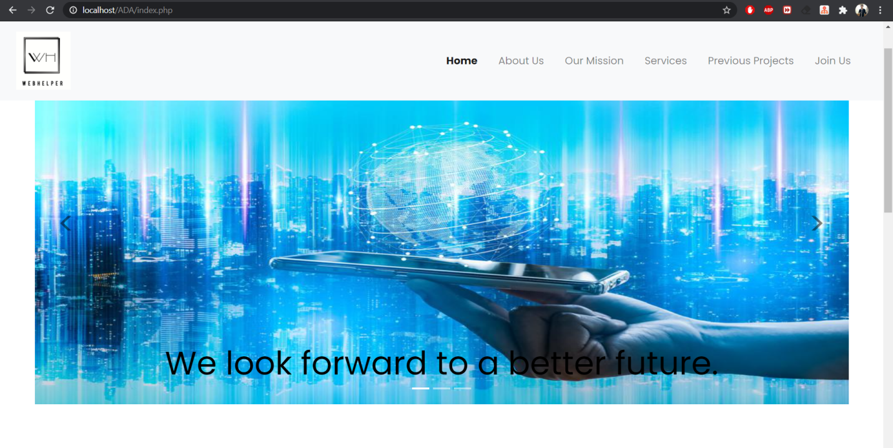
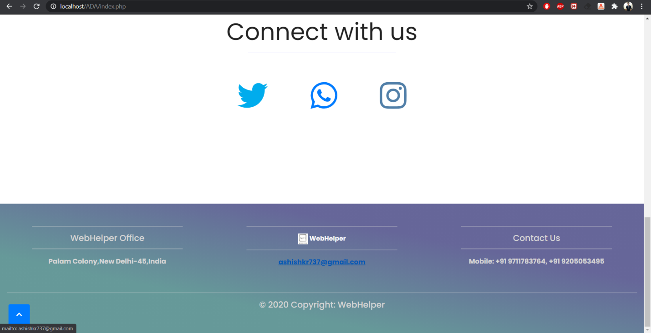
EXPLANATION OF DIFFERENT MODULES WITH SNAPSHOTS
Header provides clickable options for different pages of the website. On the left side of header there is company logo and on the right there is navigation bar.
It has slideshow of 3 slides which changes with a set timer and also by the arrow head symbol.
On the bottom left corner there is an arrowhead facing up in all of the pages of the website. It is the scroll to top button. It takes the user to the top of the page.
HOMEPAGE
Then there is option to connect with us on different social media platforms, namely Twitter, WhatsApp, and Instagram. On clicking on any of the 3 app icons, a redirect triggers which directly takes user to the profile’s feed or chat box of the respective web apps.
Footer of the homepage has 3 fields, including postal address, email and phone numbers.

Slide 5
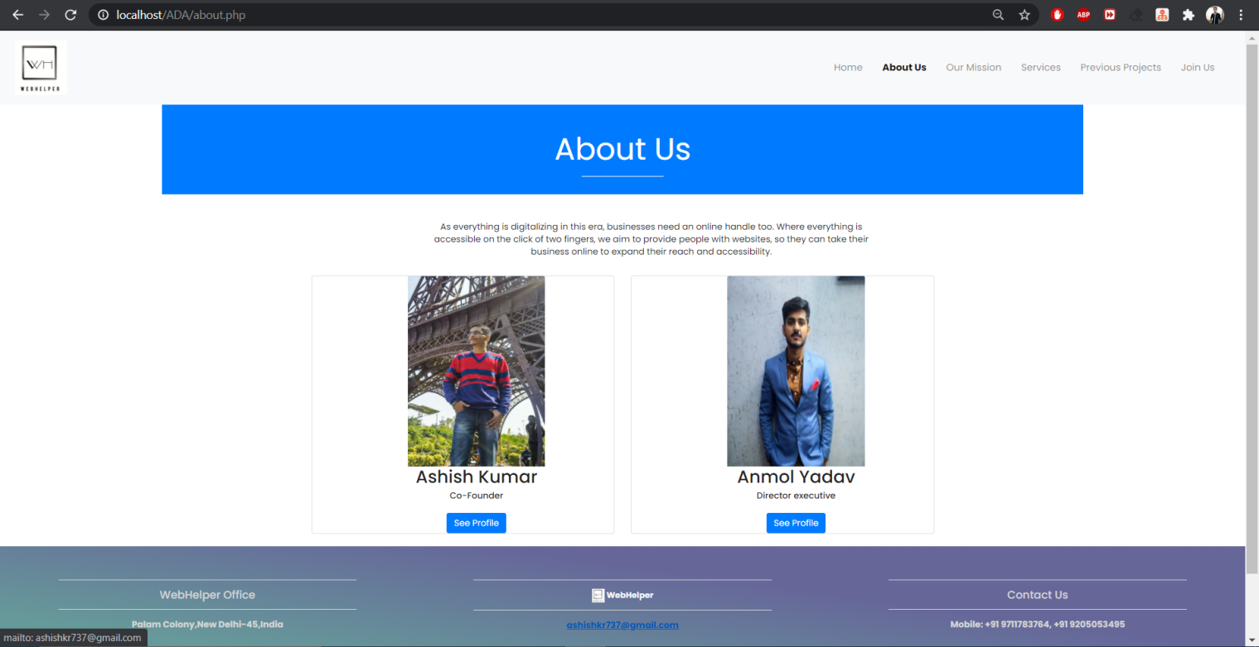
On clicking ‘About Us’ on the header of the website, a new page loads which consists the idea behind starting this company.
There are 2 photographs of the persons behind this startup initiative, with name and post in the company.
There is one button under each photograph, clicking on which, a redirect triggers which opens their personal profiles on LinkedIn, and Instagram respectively.
ABOUT US
Header and footer is same for all the pages in this website.

Slide 6
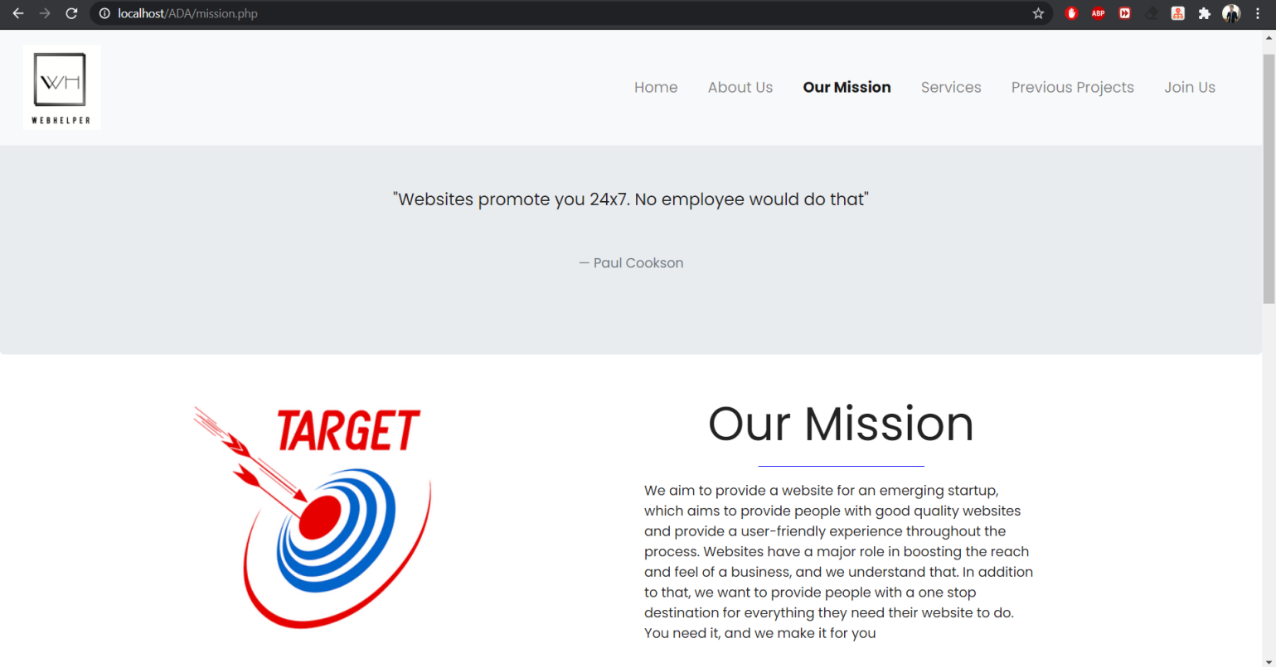
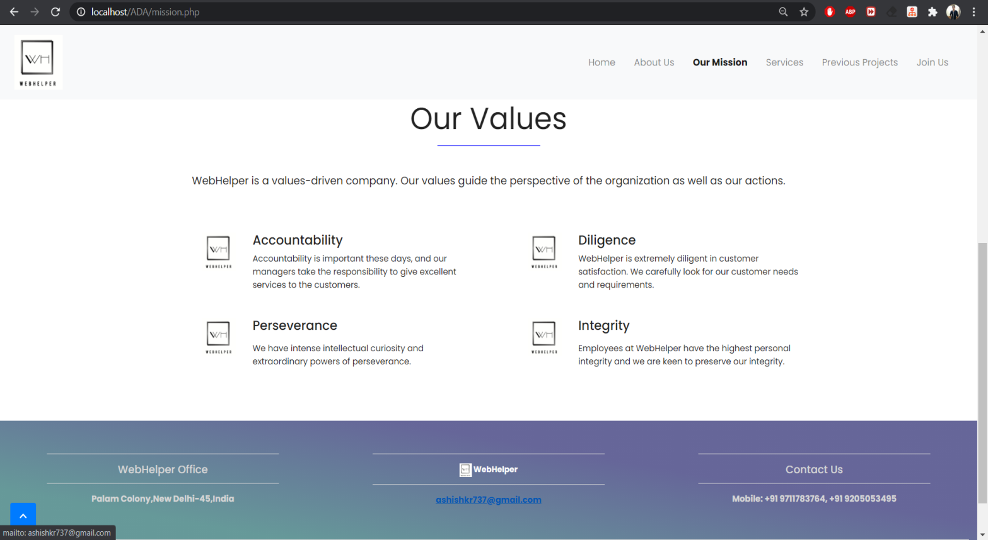
A quote is displayed about websites in general.
Then the aim of this startup is mentioned under ‘our mission’ heading, which highlights the basic idea behind our startup and our objectives of customer experience.
OUR MISSION
WebHelper is a value driven company which guides the perspective of the organization as well as the actions.
Scrolling down we have mentioned 4 basic values behind our startup which are accountability, diligence, perseverance and integrity.

Slide 7
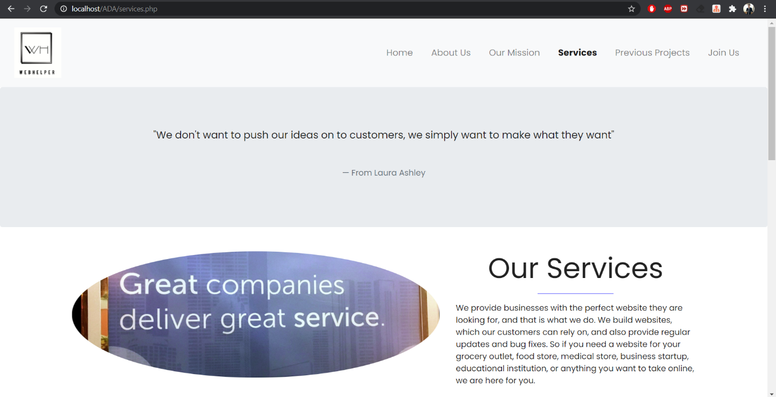
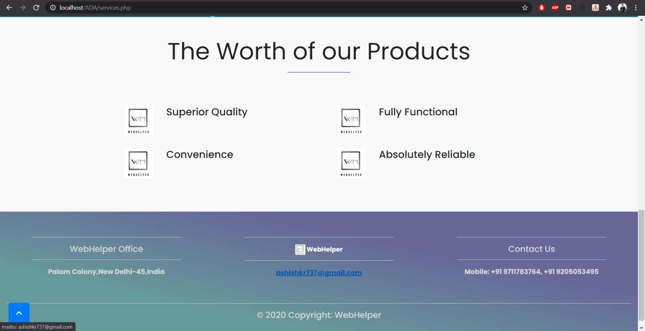
The services that we provide are mentioned under ‘our Services’ heading, which highlights what we do for the customers and how we make fully functional websites of any startup that customers are looking for.
SERVICES
Then on scrolling down, worth of products we provide is mentioned. We provide superior quality websites with costumer attractive ideas, fully functional which is convenient to clients and easy to use.
The site that we make for the clients is absolutely reliable in all the major aspects.

Slide 8
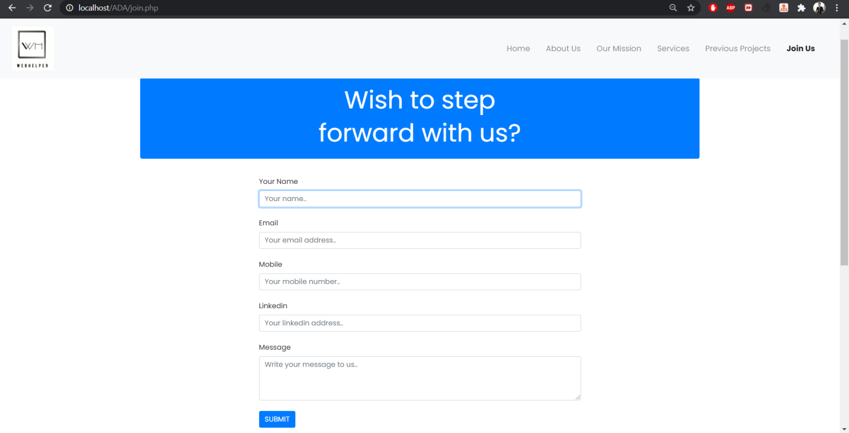
Join us page is for the developers interested in working with us and for the users who wants to make website for their company.
A tab appears labeled as ‘wish to step forward with us’; clicking on which, a form appears.
There are 5 fields to be entered by the user.
Every field has validity checks.
No field can be left empty or of invalid format.
Submitting the form stores the entered data in the database, which is accessible to us. From there we can contact the person who submitted the form.
JOIN US
CLICKING ON ‘PREVIOUS PROJECTS’ REDIRECTS TO GITHUB WHERE OUR PREVIOUS PROJECTS ARE LISTED.

Slide 9




TOOLS AND TECHNOLOGIES USED
Front End Technologies: html, CSS, Bootstrap, JavaScript
Back End Technologies: PHP, SQL
Versions of these technologies used: html5, CSS3, Bootstrap 4.0.0, ECMAScript 5, PHP 7.4.11
IDE: Sublime Text 3
Website is hosted on: http://localhost/phpmyadmin/
Server: XAMPP server
Server version: 10.4.14 - MariaDB - mariadb.org binary distribution

Slide 10
BIBLIOGRAPHY
IMPLEMENTATION CODE
Github link: https://github.com/ashishch164/WebDev_Projects/tree/master/WebHelper
https://medium.com/@solodev/add-a-scroll-to-top-button-to-your-website-ece1ed82d72e
https://getbootstrap.com/docs/4.5/components/carousel/
https://getbootstrap.com/docs/4.5/components/navbar/
https://getbootstrap.com/docs/4.5/components/forms/
https://mdbootstrap.com/docs/jquery/navigation/footer/

